Slide 1

Geetanjali Institute of Technical Studies, (Udaipur)
An
Internship presentation
submitted to
Department of Computer Science & Engineering
Submitted By:-
Mayank Joshi
Roll No.: 19EGICS065
Internship Carried Out
At
Department of Computer Science & Engineering
Geetanjali Institute of Techincal Studies
Rajasthan Technical University
November,2021

Slide 2
Topics to be covered in this presentation:-
1.What is python ?
2.Advantages of python over other languages.
3. Python module.
4.Python for AI(Artificial Intelligence), ML(Machine Learning), Dl (Deep Learning)
5.About Project.
6. Need of the project.
7.Future scope of the project.
8. References.

Slide 3
What is Python ?
1. Python is an interpreted.
2. Object-oriented high-level programming language with dynamic semantics.(Like Facebook in concept of OOPs)
3. Its high-level built in data structures, combined with dynamic typing and dynamic binding, make it very attractive for Rapid Application Development(Through KIVI in android), as well as for use as a scripting or glue language to connect existing components together.
4.Python's simple, easy to learn syntax emphasizes readability and therefore reduces the cost of program maintenance.
a=20
b=30
print(a+b)
5.Python has predefined modules so we import module and use the functionality of module.(Built in module like random, time, Tkinter)
6.Open source , platform-independent and free to use.

Slide 4
Advantages of python over other languages
--Advantages:-
1. Simple syntax.
2. Strong library.
3. Interpreted Language
4. Dynamically Typed(Decision takes on runtime)
5. Free and Open-Source
6. Portability.
--Disadvantages:-
1. Slow Speed
2. Not Memory Efficient

Slide 5
Python module
Python basics(List, tuple, loop, functions, OOPs)
GUI apps with python(tkinter)
Web apps with python(Django)
Python for ML&AI(Sklearn, matplotlib)
Big data analytics(hadoop)

Slide 6
Python for ml, ai & dl
Machine Learning (ML):- is basically that field of computer science with the help of which computer systems can provide sense to data in much the same way as human beings do.
Artificial Intelligence:-Artificial intelligence (AI) is a wide-ranging branch of computer science concerned with building smart machines capable of performing tasks that typically require human intelligence.
Deep learning:-Deep Learning is a subfield of machine learning concerned with algorithms inspired by the structure and function of the brain called artificial neural networks.(neaurons)

Slide 7
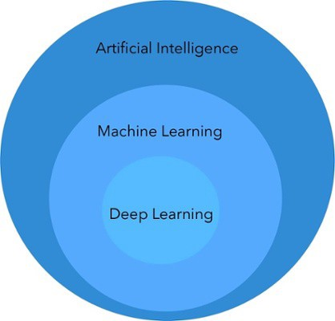

Slide 8
About project
Color changing game using tkinter module in python.
In this game player has to enter color of the word that appears on the screen and hence the score increases by one, the total time to play this game is 30 seconds. Colors used in this game are Red, Blue, Green, Pink, Black, Yellow, Orange, White, Purple and Brown. Interface will display name of different colors in different colors. Player has to identify the color and enter the correct color name to win the game.

Slide 9
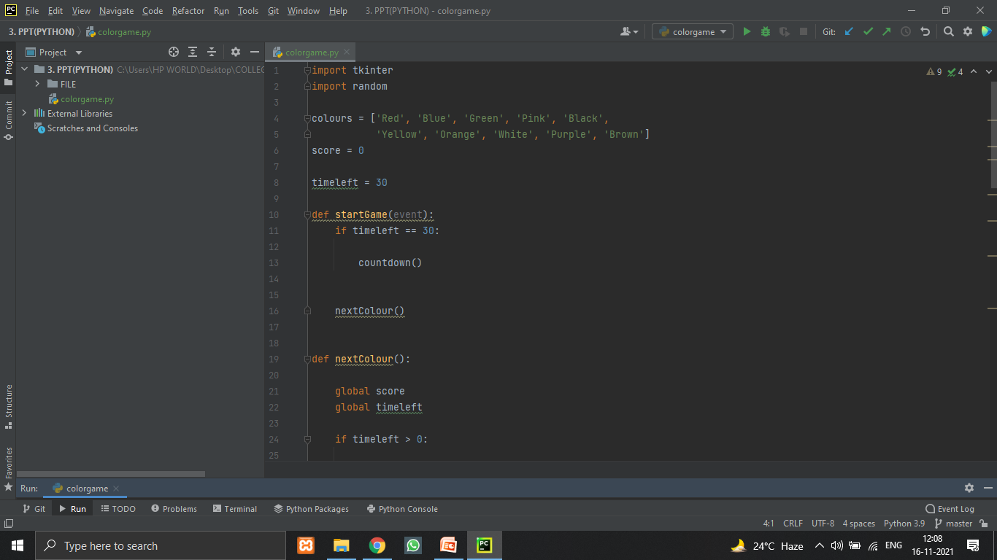
Code of the project

Slide 10
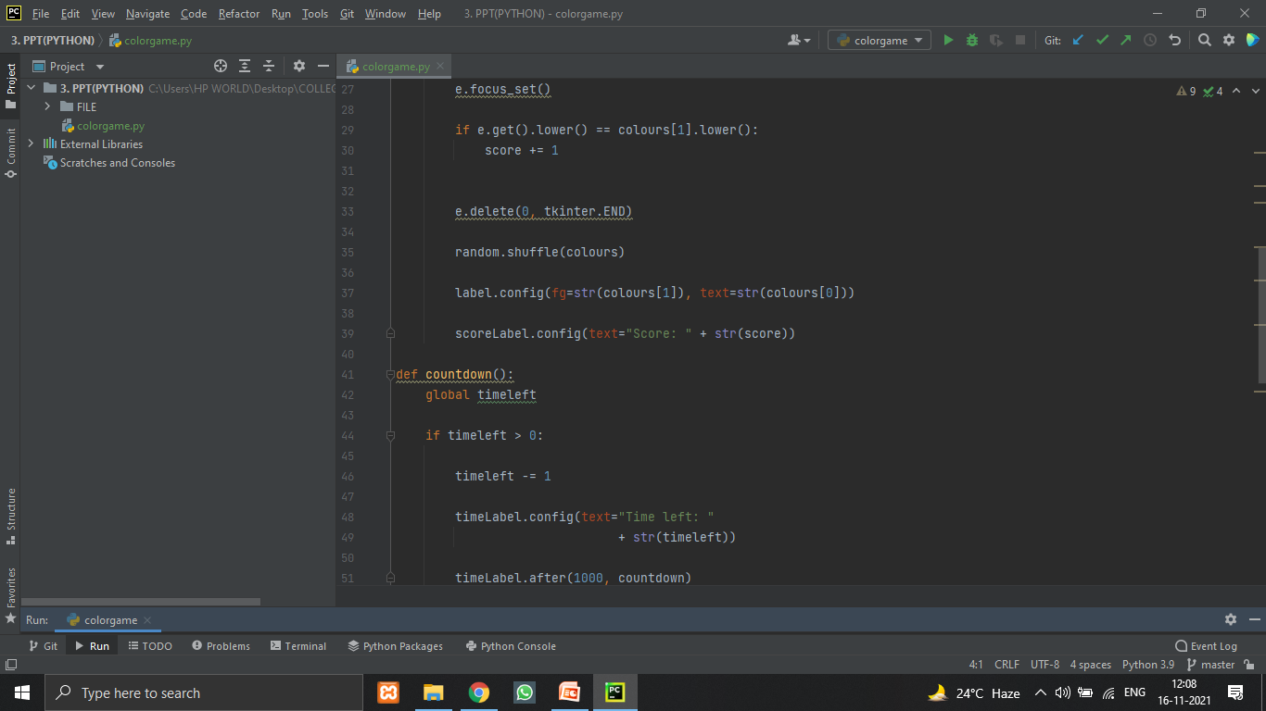

Slide 11
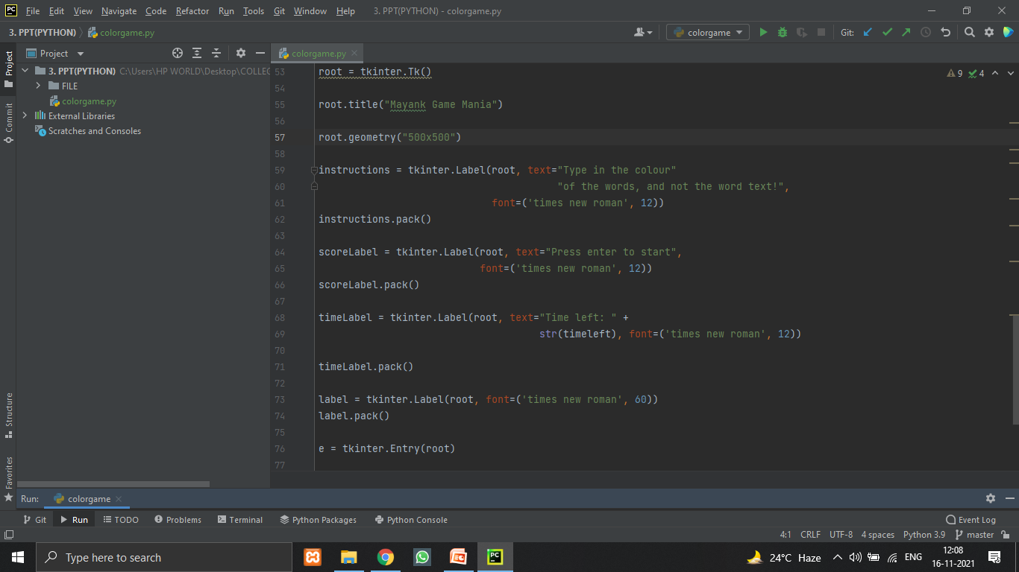

Slide 12
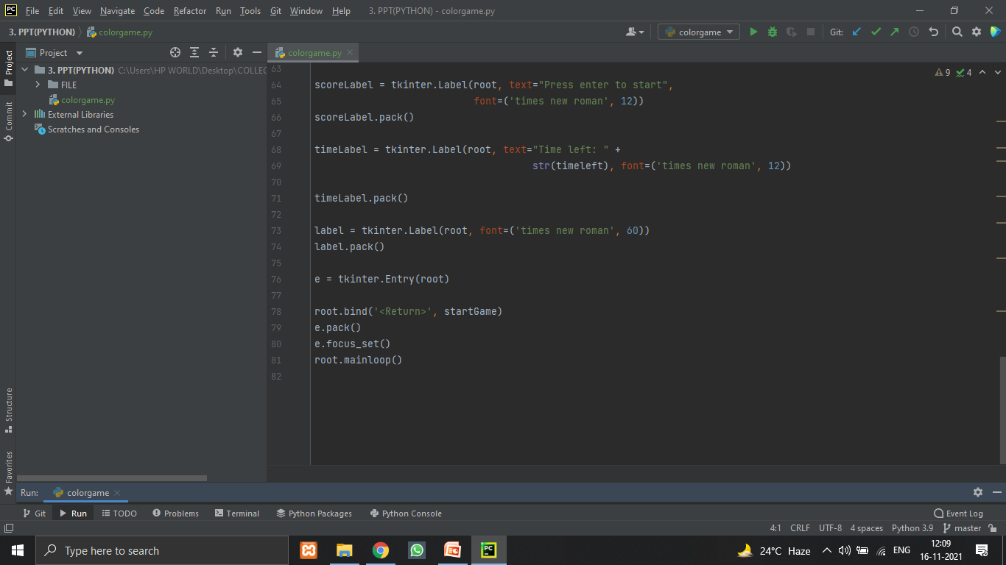

Slide 13
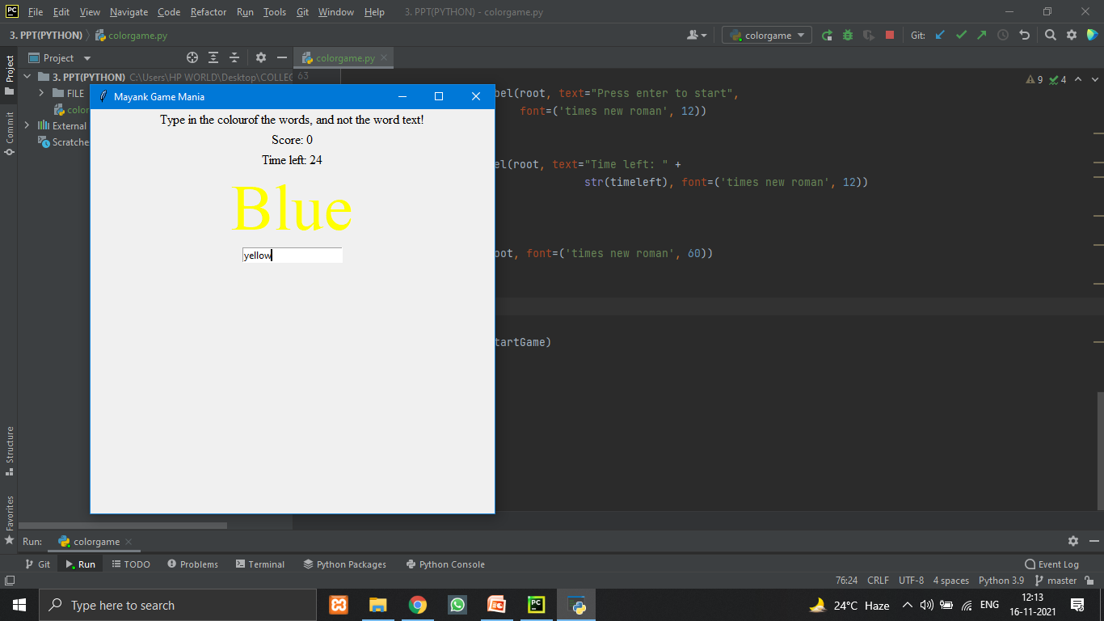

Slide 14
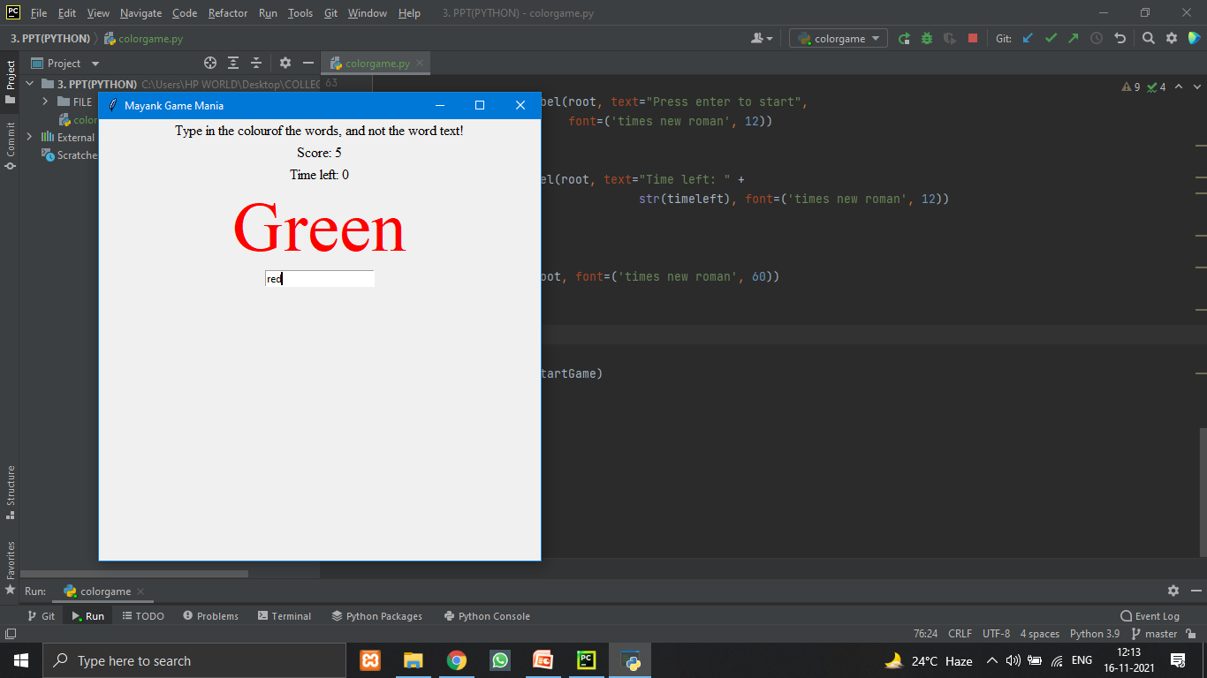

Slide 15
Need of the project
Because of coding too much and stuck much time on screen. Our mind is frustrated so this is the main reason for making this game to reduce the stress level of mind.

Slide 16
Future scope of the project
1. Add database in this project. So if the user again login to the project then he/she must see there past records.
2. Add login page also.

Slide 17
Reference
https://www.w3schools.com/python/python_lists.asp
https://www.tutorialspoint.com/python/python_modules.htm
https://www.geeksforgeeks.org/python-gui-tkinter/
https://www.w3schools.com/python/python_functions.asp

Slide 18
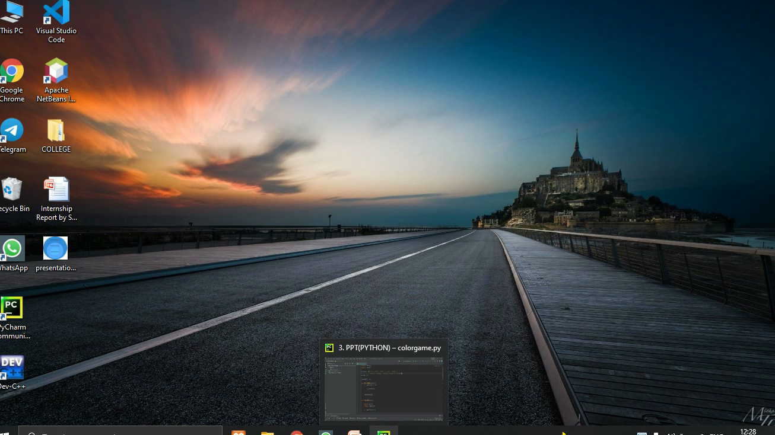

Slide 19
THANK YOU FOR GIVING ME YOUR PRECIOUS TIME.

